Slide 1
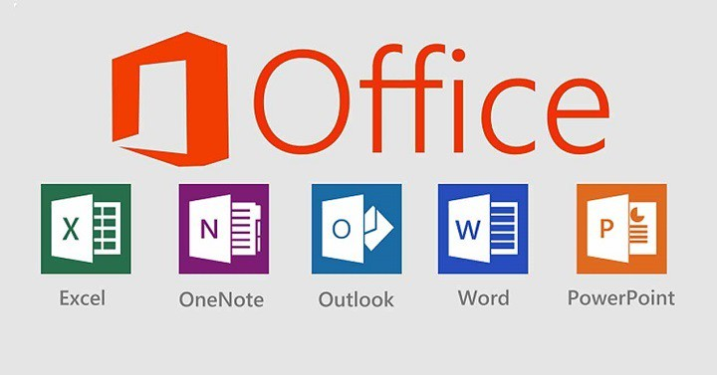
How to make a Microsoft Office 2016 Activation

Slide 2
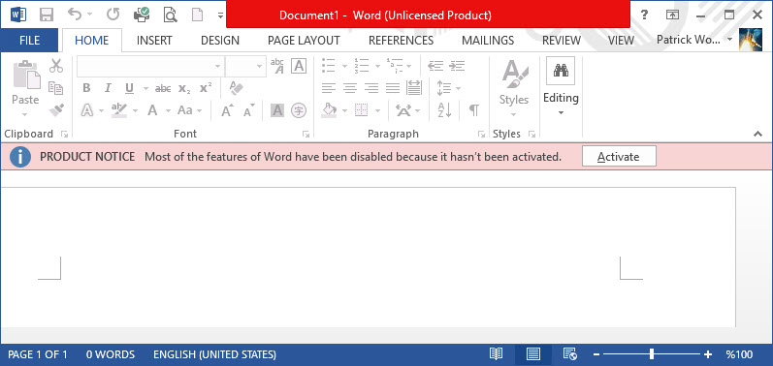
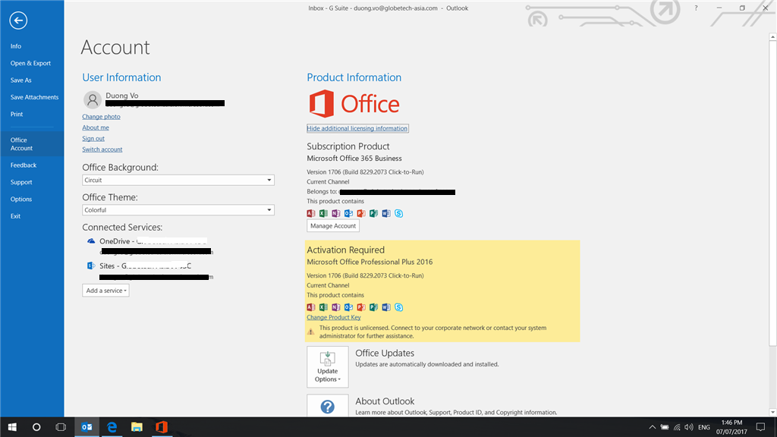
Unlicensed Microsoft Office

Slide 3

STEP 1
Go to browsers –Mozilla Firefox ,Google Chrome, Opera, Safari, Internet Explorer or Microsoft Edge

Slide 4
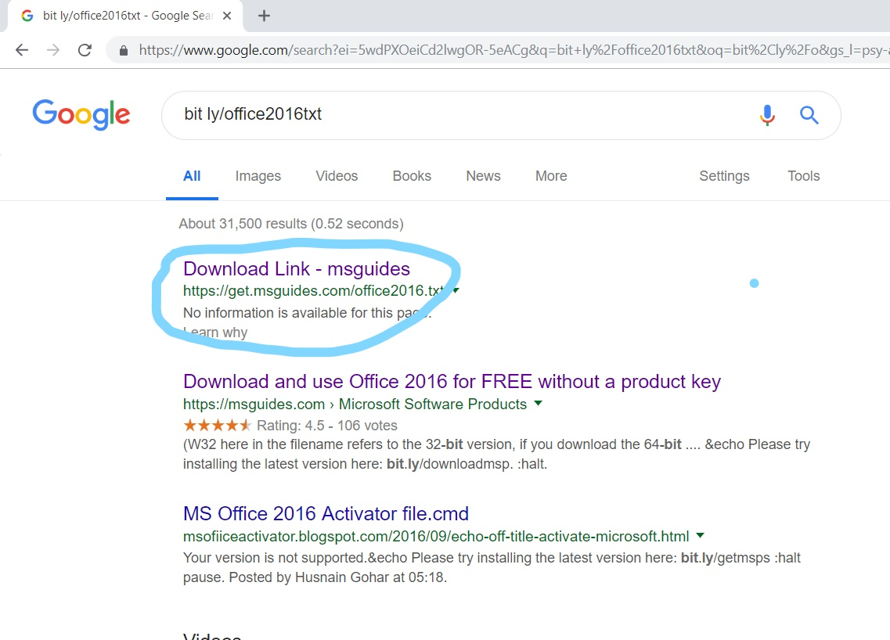
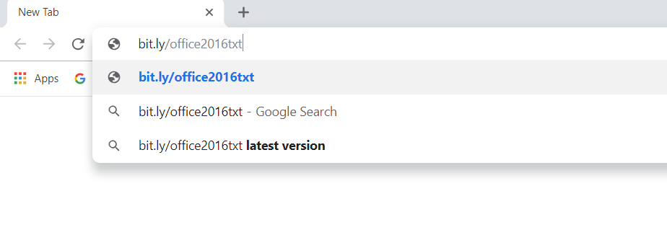
STEP 2
Go research “ bit.ly/office2016txt “

Slide 5
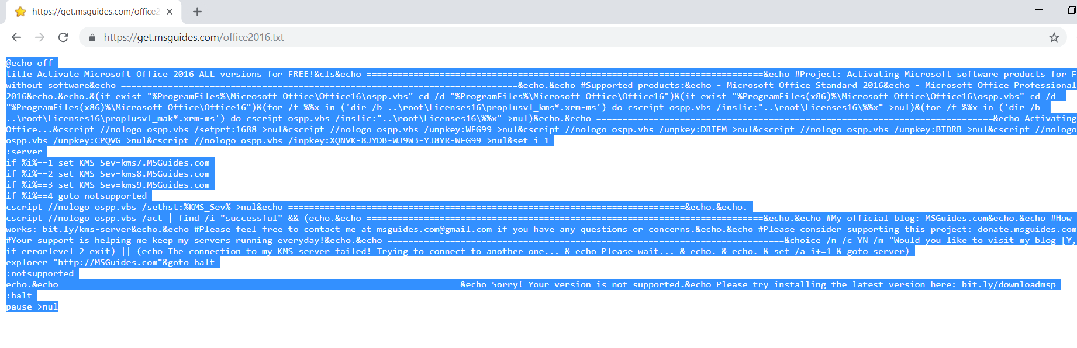
STEP 3
Click it and Then Copy it all

Slide 6
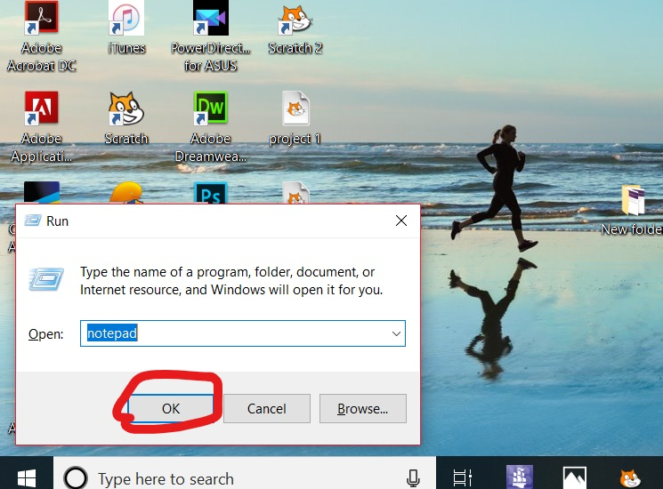
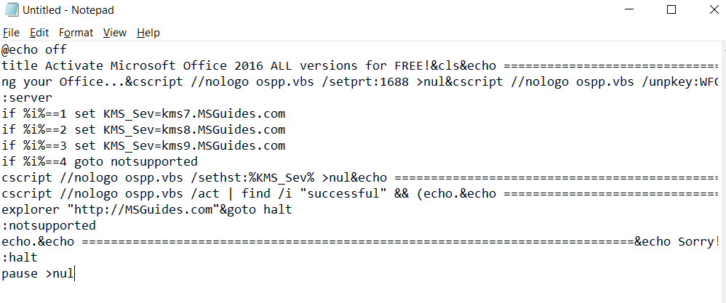
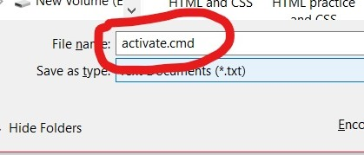
STEP 4
Go to Notepad Start + R
You will see Notepad
Then Paste(ctrl + v)
Save it But We need to out
“File Name: Name.cmd”

Slide 7
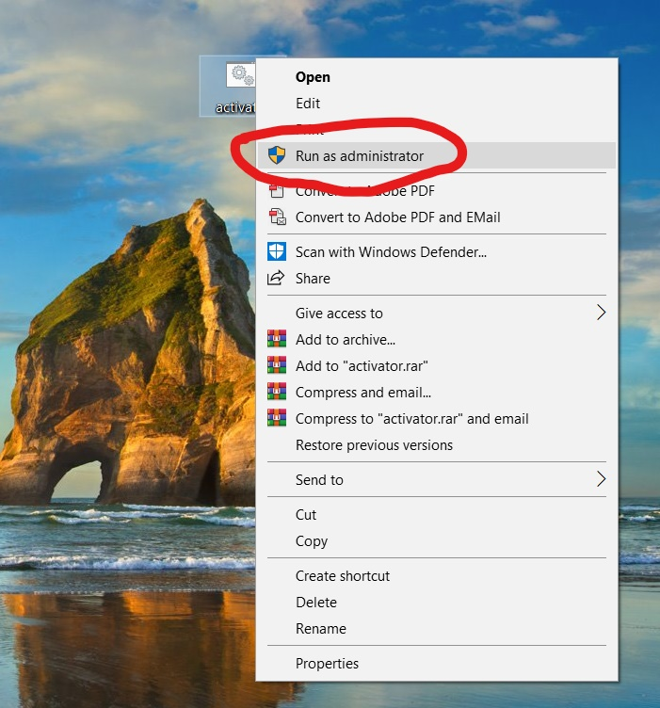
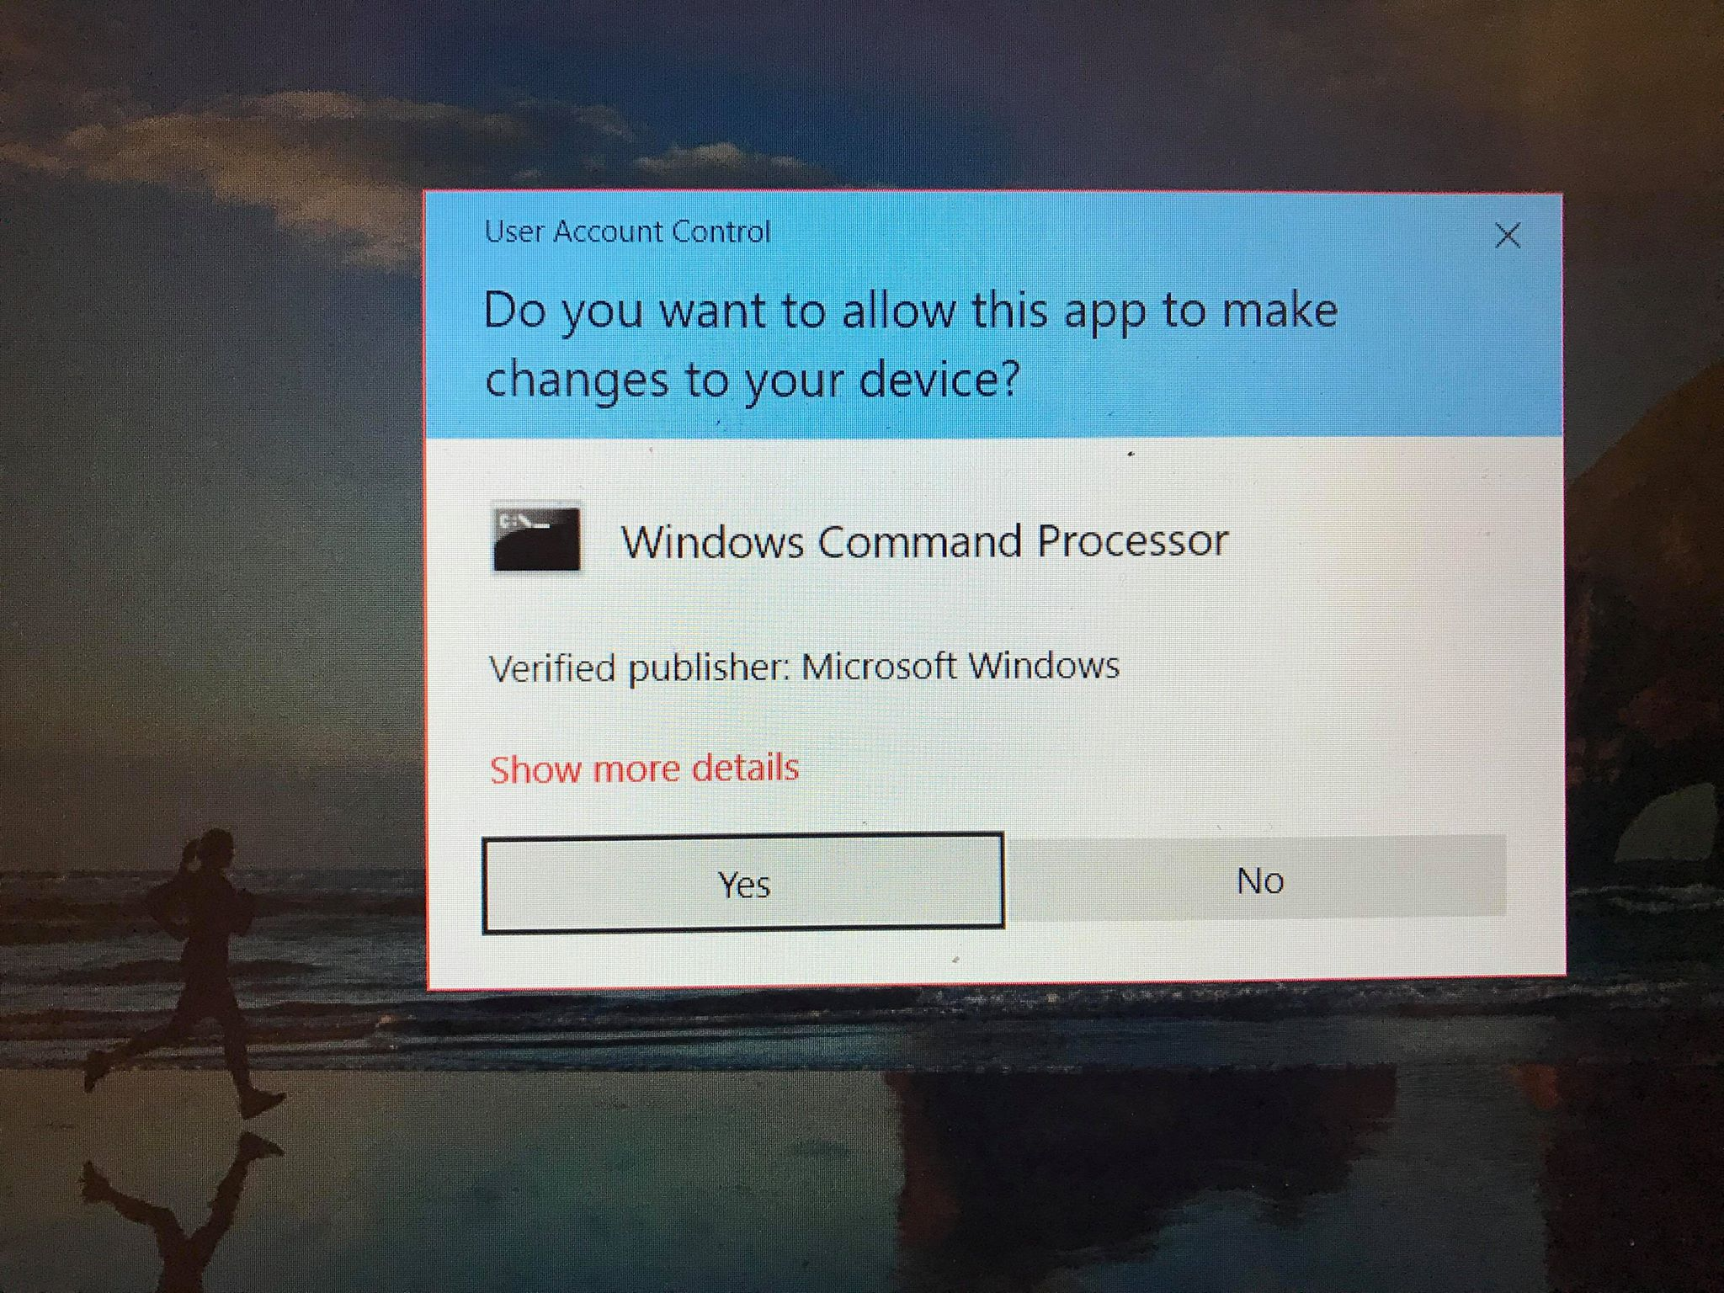
STEP 5
Go to this File and Click “Right Mouse”
Click Run as administrator
You will see Like this and Then Select
“ Yes”

Slide 8
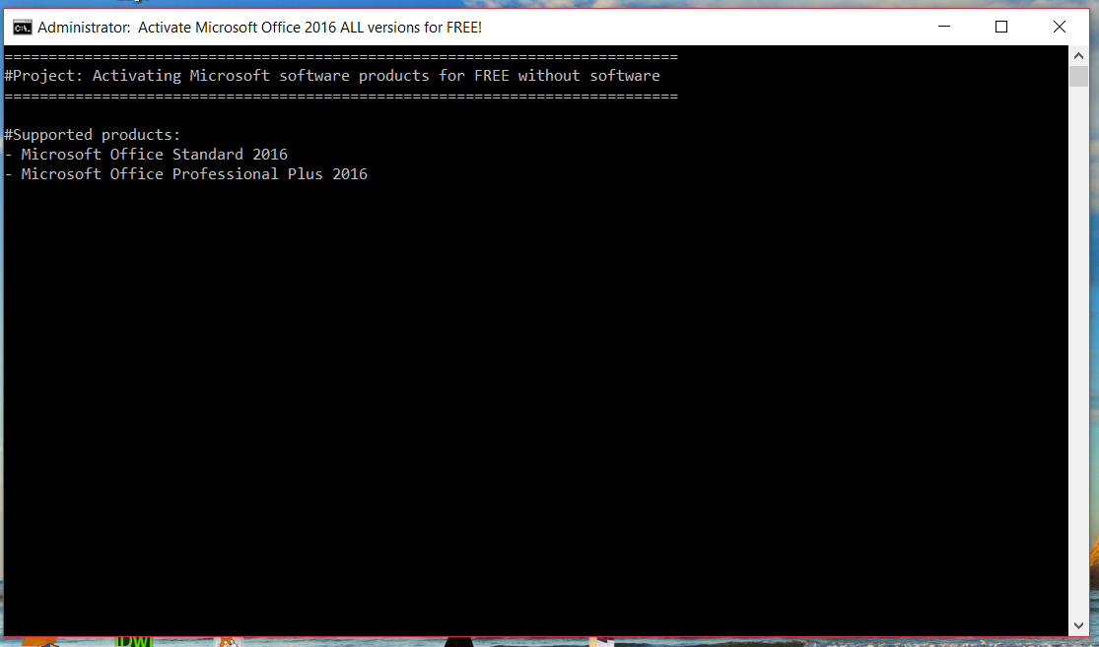
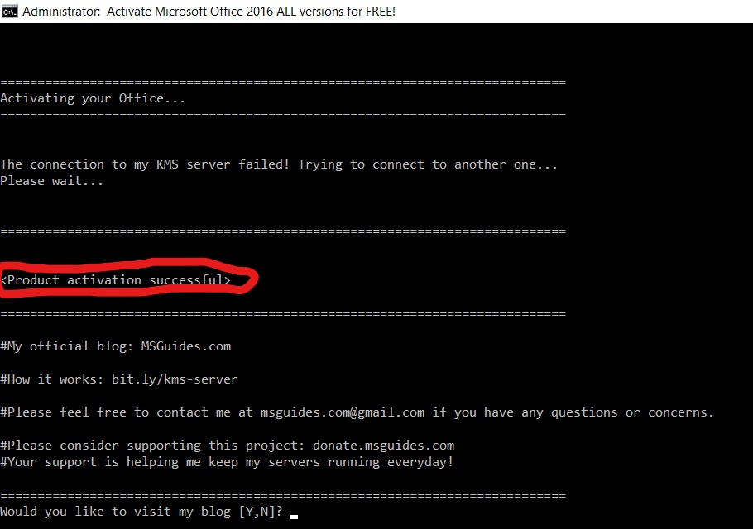
STEP 6
You will see Command Prompt
Wait for in short of minute ,
It will display “Product activation
Successful”

Slide 9
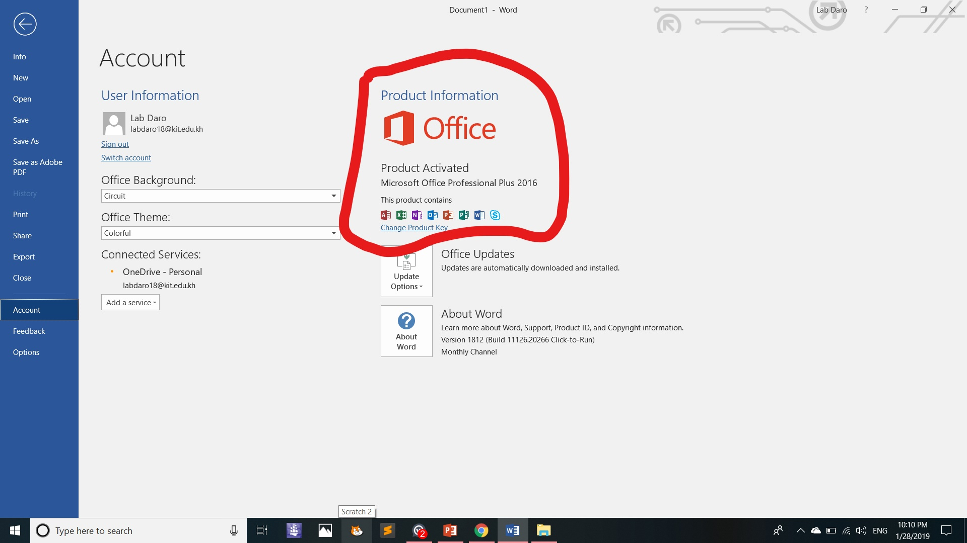
We can check
You Microsoft is licensed !!!!

Slide 10
Thank For Your Listening

